Slide 1
Interoperability of Metadata Standards in Cross-Domain Science, Health, and Social Science Applications
Steven McEachern, Joachim Wackerow, Simon Cox, Simon Hodson
SciDataCon-IDW 2018, Gaborone
Session Title: Data Integration for Science –
a major global challenge for interdisciplinary research

Slide 2



Goals
Metadata are critical for data integration. They support:
Data discovery
Selection
Access
Use
Support cross-discipline data integration and analysis
with a consideration of standards from the social, health and environmental sciences
along with generic all-purpose metadata standards
With the background of the pilot projects of the CODATA data integration initiative as uses cases:
Infectious diseases
Resilient cities
Disaster risk reduction

Slide 3
Areas of Discussion
Common rules for metadata specifications
Advantages and limitations of generic approaches
Techniques for profiling or specializing generic standards for specific applications
Best practices for setting up domain-specific data/metadata for cross-domain use
Controlled Vocabularies, domain-independent and useful domain-specific ones
Contact points/overlaps of specifications, crosswalks and transformations
Identification of gaps. Possible workarounds, possible areas for future specifications

Slide 4




Overview on Workshop
5-day workshop
24 international domain and technical experts
Schloss Dagstuhl – Leibniz Center for Informatics, 1 – 5 October 2018, Wadern, Germany
organized by
Simon Cox (CSIRO Australia and W3C Dataset Exchange Working Group)
Simon Hodson (CODATA)
Steven McEachern (Australian National University and DDI Alliance)
Joachim Wackerow (GESIS - Leibniz Institute for the Social Sciences and DDI Alliance).
The event was sponsored by
CODATA (the Committee on Data of the International Science Council)
Data Documentation Initiative Alliance (DDI)
and subsidized by the Dagstuhl institute

Slide 5
Dimensions in the Interdisciplinary Use of Data and Metadata
From high-level to detail:
How to support discovery of data on the basis of a high-level description, and possibly also on more details like concepts related to observations and variables?
From domain-specific to cross-domain:
How can domain-specific data/metadata be transformed in a way that cross-domain approaches regarding discovery and analysis can be supported?

Slide 6

In the Light of FAIR Cross-Domain FAIR Challenges
Findable – discovery across domains
Accessible – microdata often protected
Assessable – evaluable and estimable?
Interoperable – domain-specific data formats and metadata standards
Re-usable
Data for research should be “intelligently open”: accessible, assessable, intelligible, and useable

Slide 7
Multiple Distinct Types of Metadata
Descriptive metadata describes a resource for purposes such as discovery and identification. It can include elements such as title, abstract, author or creator, and keywords.
Structural metadata is metadata about containers of data and indicates how compound objects are put together, for example, how pages are ordered to form chapters. It describes the types, versions, relationships and other characteristics of digital materials. Structural metadata can also provide automatic and/or partially automatic data profiling and data validation support.
Administrative metadata provides information to help manage a resource, such as when and how it was created, an assessment of its reliability, its file type and other technical information, and who can access it.
Reference metadata describes the contents and quality of statistical data
Statistical or process metadata describes the processes that collect, clean and transform source data to produce statistical data. Process metadata enables the construction of data pipelines and automatic repeatable processes both within and between organizations.

Slide 8
Issues in Discovery and Assessment of Datasets
Not precise enough:
General keywords, subject headings – not tied to a well-governed terminology
Abstract
Not processable by program:
Link from metadata to data often obscured by an intermediate „landing page“

Slide 9
Possible Solutions
More precise semantics with tags on
variables, properties or dimensions reported in the dataset
the target entity or population that a dataset describes
the sample(s) of that entity used in the specific investigation
provide summary statistics to indicate thematic, geographic and temporal scope and resolution of a dataset
Question: How can i.e. DCAT support these in combination with domain-specific standards?

Slide 10
DDI 4 Outlook: Potential in Cross-Domain Use
Large parts of DDI 4 are independent from the social science domain, especially in the areas of
Conceptual
the target entity or population, theoretical concepts
Data description
variable cascade which links conceptual definitions down to the instance variable
datum-based approach which enables the description of data in many forms (also data lakes and legacy forms)
Workflows (for process description)
Patterns of BPMN (Business Process Model and Notation)
Use DDI to Document, Discover and Interoperate

Slide 11

DCAT Profile for DDI
Example for handover from generic level to specific level
See presentation „Harmonising data description across the social and natural sciences”, Simon Cox et al.
Profiles of DCAT are required for specific applications and disciplines (from DCAT revised edition 2018)
Machine-readable specifications of application profiles need to be easily publishable, and optimize re-use of existing specifications (from ongoing DXWG work, issue 75)

Slide 12
Discussed Metadata Standards
Study- or collection-level: DCAT, Dublin Core, ISO 19115-1, DDI 4, DISCO, DATS
Variable and dimension level
Microdata: DDI 4, W3C SSN, FHIR-HL7, CDISC, EML, SensorML, GSIM, ISO/IEC 11179, ISO/IEC 11404
Aggregate data: W3C DataCube, ISO 19123, DATS, DDI
Provenance: W3C PROV-O, ISO 19115-2
Workflows/data transformation: DDI 4
Some of these standards are focused on the data within a particular discipline or domain. Others are more general in scope.

Slide 13
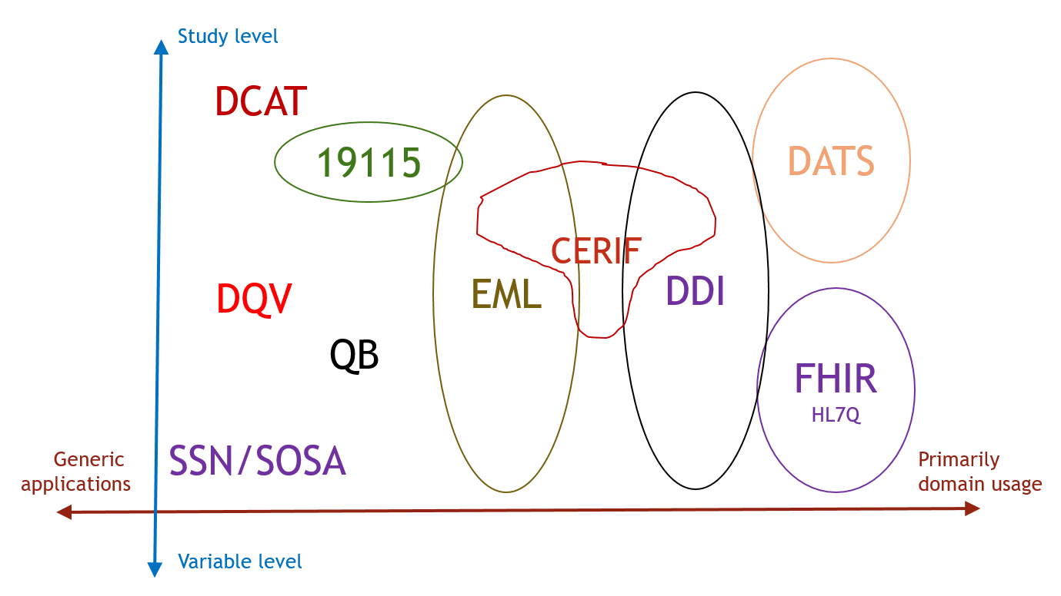
Summary of Relation of Used Metadata Standards

Slide 14
Classification of the Technical Specifications
 | Technology | Governance | License | User community | Where used
CERIF | E-E-R, DBMS | euroCRIS |  | EPOS, ENVRI+, CRIS | Europe, some US Universities
DATS | JSON-schema → JSON-LD schema.org + OBO | NIH Data Commons GitHub | CC-BY SA 3.0 | DataMed Biomedical
DCAT | RDF | W3C | Open | EC, Google, CKAN | Europe, Australia
DDI | 3.2 - XML 4.X - UML → XML, RDF | DDI Alliance | Open GPL3 | Social Sciences, Official statistics, public health | Global, World Bank
DQV | RDF | W3C | Open
EML | XML/XSD | "EML Community" (Matt Jones) |  | Ecosciences and nearby | USA, LTER jurisdictions
FHIR | FHIR StructureDefinition → REST, XML, JSON, RDF | HL7/ANSI | CC0 | Health data software developers | USA, Europe, Australia, Russia, China, ...
ISO 19115 | UML → XSD | ISO/TC 211 | © $ | Geographic information, Government agencies | Worldwide
QB | RDF/SKOS | W3C | Open | Statistics bureaux | European Central Bank ...
SSN/SOSA | RDF/OWL | W3C | Open | Ontology researchers

Slide 15
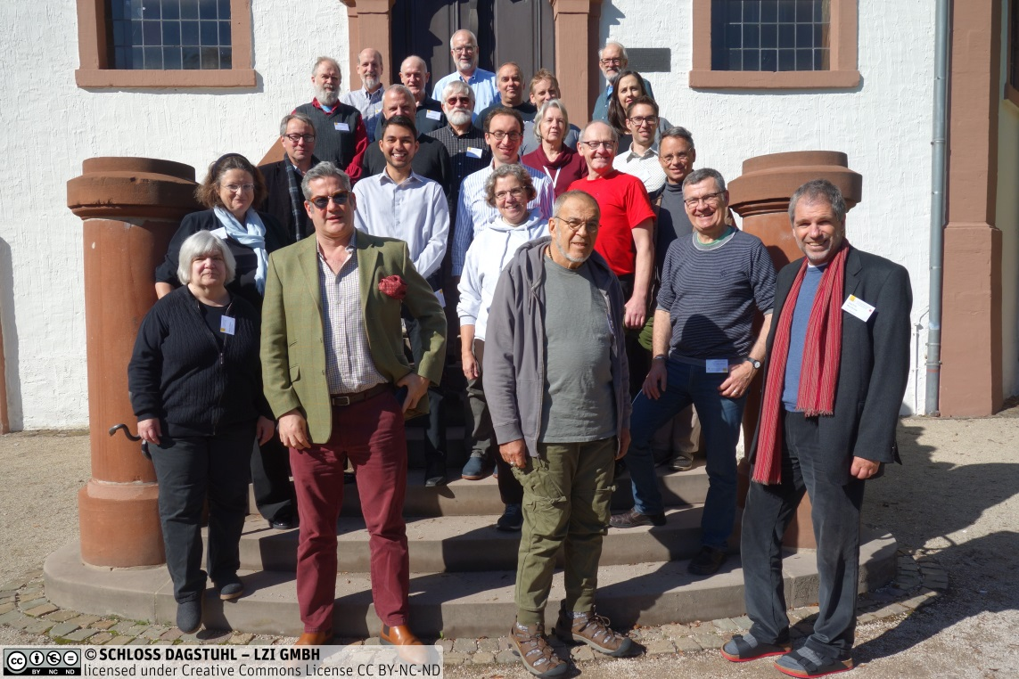
Partipants
Phil | Archer | Consultant
Adrian | Burton | Australian National Data Service
Simon | Cox | CSIRO
Michelle | Edwards | University of Guelph
Dan | Gillman | BLS - U.S. Bureau of Labor Statistics
Alejandra | Gonzalez-Beltran | Oxford e-Research Centre University of Oxford
Jay | Greenfield | Consultant
Arofan | Gregory | Consultant
Armin | Haller | ANU
Simon | Hodson | CODATA
Larry | Hoyle | University of Kansas, Institute for Policy & Social Research
Rebecca | Koskela | DataONE
Steven | McEachern | Australian Data Archives, Australian National University
Bill | Michener | DataONE
Virginia | Murray | University of Cambridge
Raymond | Plante | NIST
Eric | Prud'hommeaux | W3C
Fernando | Reis | Oxford University
Steve | Richard | Columbia University
Harold | Solbrig | Johns Hopkins University
Wendy | Thomas | University of Minnesota, Minnesota Population Center
Philipp | Ulbrich | Ecological Sequestration Trust
Joachim | Wackerow | GESIS - Leibniz Institute for the Social Sciences
Peter | Winstanley | Scottish Government
Workshop Wiki

